Slide 1
Improving Multi-hop Question Answering over Knowledge Graphs using Knowledge Base Embedding
Apoorv Saxena，Aditay Tripathi，Partha Talukdar
ACL-2020
汇报人：冯雅茹

Slide 2
content
01
03
Background
Experiments
02
04
Model
Conclusion

Slide 3
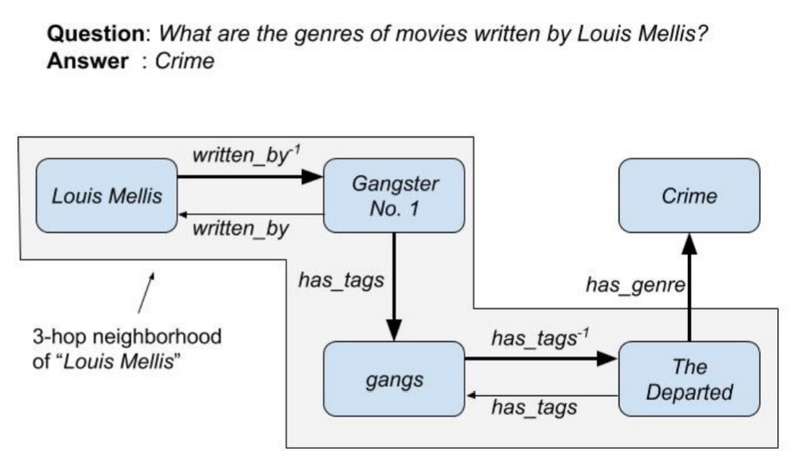
Background
Given a set of entities E and relations R, a Knowledge Graph G is a set of triples K such that K ⊆E × R × E . A triple is represented as (h, r, t).The problem in KGQA involves, given a natural language question q and a topic entity eh∈ E present in the question, the task is to extract an entity et∈ E that correctly answers the question q.

Slide 4
Motivation
Motivation
KGs are often incomplete with many missing links, posing additional challenges for KGQA, especially for multi-hop KGQA.
KG embedding methods have been proposed to reduce KG sparsity by performing missing link prediction.

Slide 5
Model

Slide 6
KG Embedding Model

Slide 7
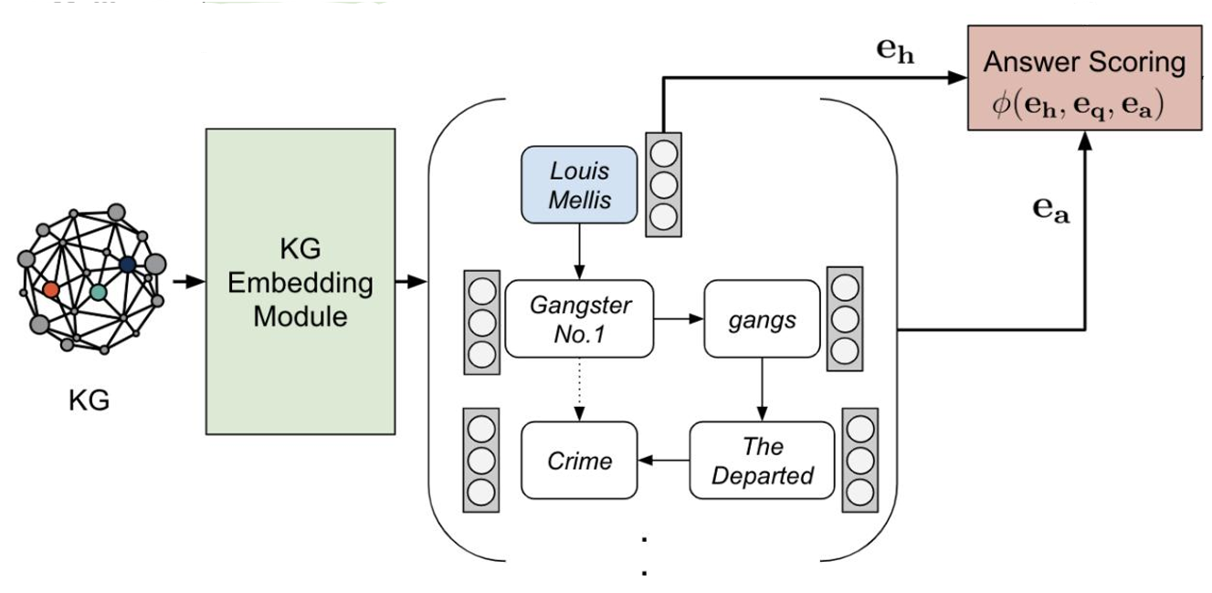
KG Embedding Model

Slide 8
Question Embedding Module

Slide 9
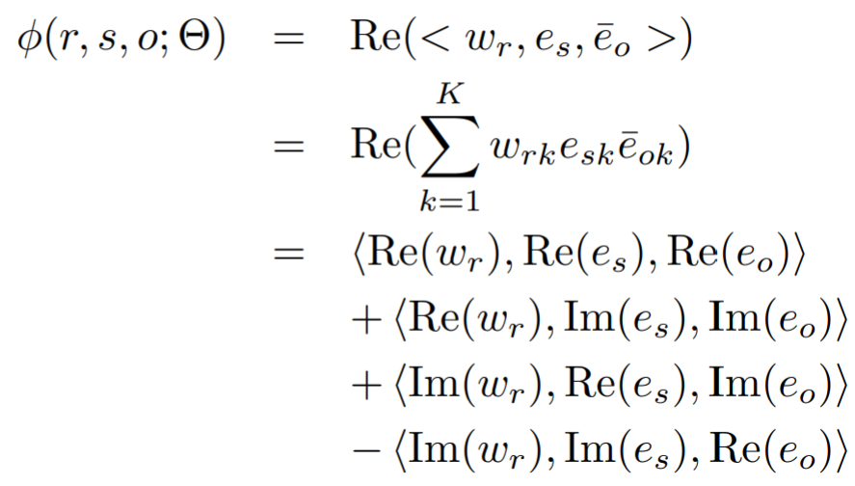
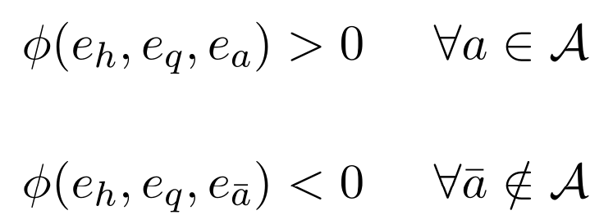
Question Embedding Module
Given a question q, topic entity h ∈ E and set of answer entities A ⊆ E, it learns the question embedding in a way such that：
complEX打分函数

Slide 10
Answer Selection Model

Slide 11
Answer Selection Model

Slide 12
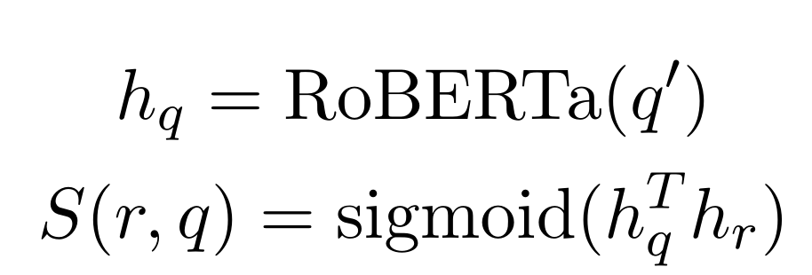
Relation matching
Similar to PullNet，the scoring function is defined as the sigmoid of the dot product of the final output of the last hiden layer of RoBERTa (hq) and the embedding of relation r (hr).
Ranks each relation r ∈ R for a given question q.

Slide 13
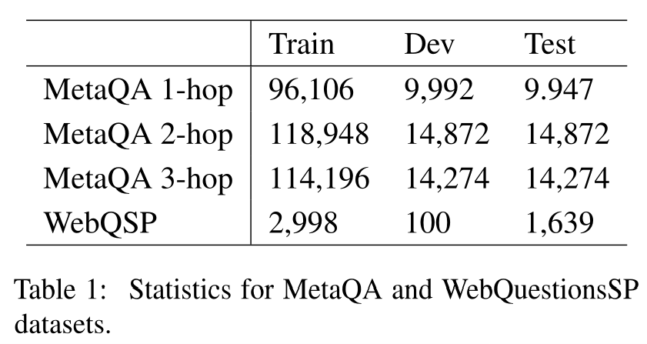
Experiments
Datasets
MetaQA: a large scale multi-hop KGQA dataset with more than 400k questions in the movie domain.
WebQuestionsSP：a smaller QA dataset with 4,737 questions.
simulate an incomplete KB by randomly removing half of the triples in the KB (we randomly drop a fact with probability = 0.5). We call this setting KG-50 and we call full KG setting KG-Full in the text.

Slide 14
Experiments
Table 2: Result on MetaQA database
Table 3: Performance on WebQuestionsSP dataset.

Slide 15
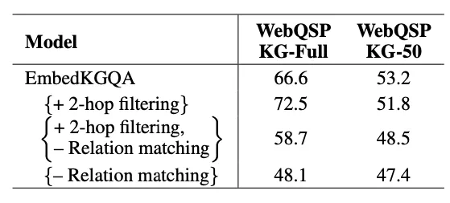
Experiments
Table 4: Effect of relation matching and neighbourhood based filtering.

Slide 16
THANKS

